Slide 1
Optimisation in parameter fitting for pandemic modelling
Date: 03/07/2020
Jack Collins
Mentor: Niall Madden
School of Maths 2020
Internship

Slide 2
Overview
Available Models
The importance of the coefficients
Working with Real World Data
Optimisation of the coefficients
Next Steps

Slide 3


Resources
MATLAB
Chebfun
MATLAB App Designer
Optimisation Toolbox for Matlab
Figures: https://uk.mathworks.com/

Slide 4
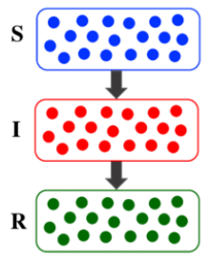
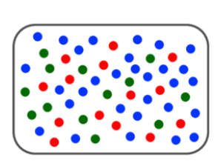
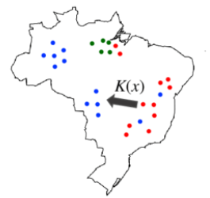
Available Models
Compartmental 2) Individual 3) Spatial
Figures:
https://www.researchgate.net

Slide 5
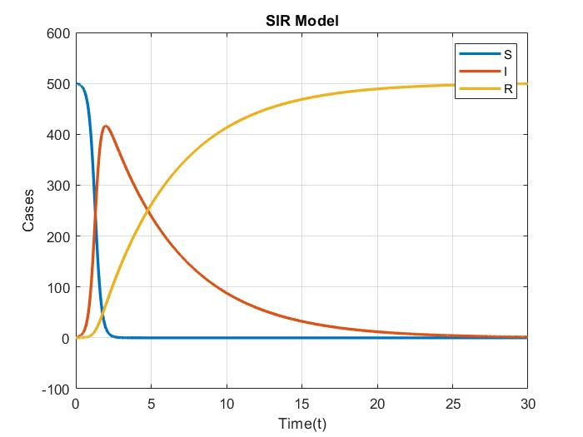
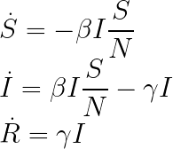

SIR Model
Three compartments:
Susceptible
Infected
Recovered
Equations:

Slide 6
The coefficients and what they mean
𝛽 = Rate of infection
𝛾 = Rate of recovery
𝛽 / 𝛾 = Reproduction number (R_0)
Applications:
Compare between regions
Evaluate restrictions

Slide 7
The Importance of the values
How sensitive is our model to coefficient changes?
Demonstration using an app developed in MATLAB app designer.

Slide 8
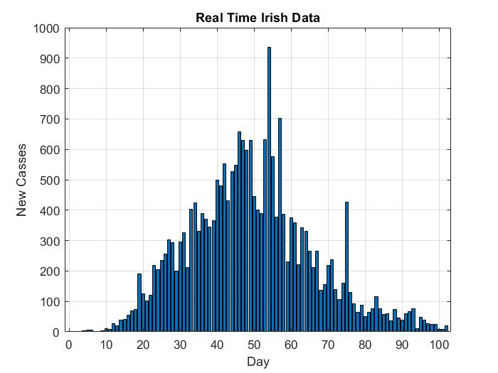
Apply to real world data
Issues:
Noise from under and over reporting
Lack of testing in initial weeks
Recovered cases not tracked
All data was gotten from https://ourworldindata.org/

Slide 9
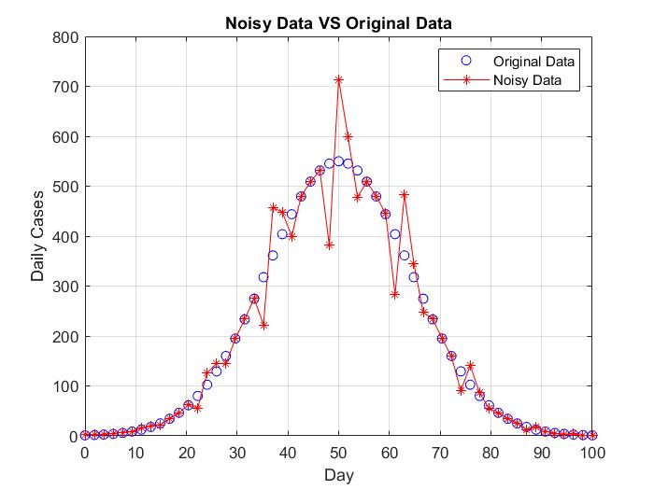
Noise Reduction
First, introduce artificial noise into the system and compare to initial values.
In order to best evaluate the noise reduction process, the artificial noise followed a 7 day trend.

Slide 10
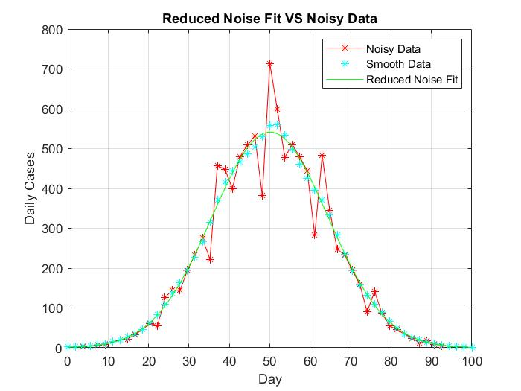
Noise Reduction
Next, explore different techniques to reduce the impact of the noise and select the most accurate.
Seven day moving gaussian distribution using the MATLAB smoothdata function

Slide 11
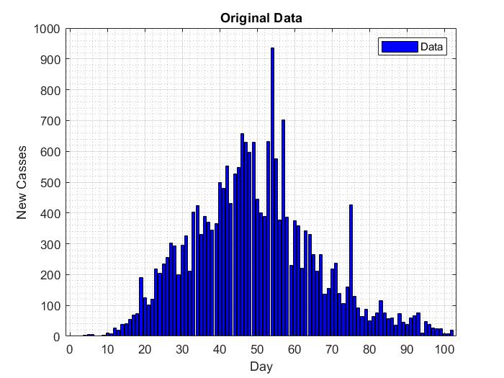
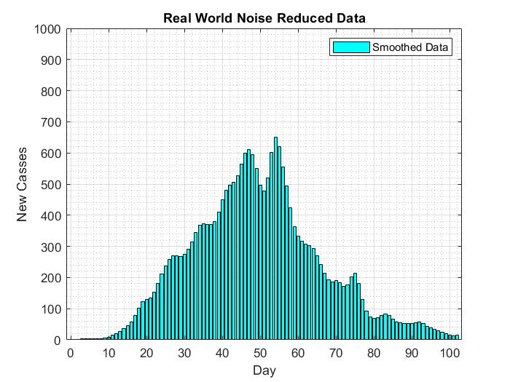
Noise Reduction

Slide 12
Coefficient Optimisation
Why do we need to?
Small changes in the coefficients lead to large changes in the fit
More reliable comparisons
Better able to evaluate policies
How?
MATLAB optimization toolbox

Slide 13

Optimisation Process
How does is work?
Choose a solver, lsqnonlin
Define our SIR model in chebfun along with the parameters and initial guesses for 𝛽 and 𝛾
It tries to minimises the individual squares of the differences between the data points and the fitted curve.
Take new values for coefficients and repeat until satisfied.

Slide 14
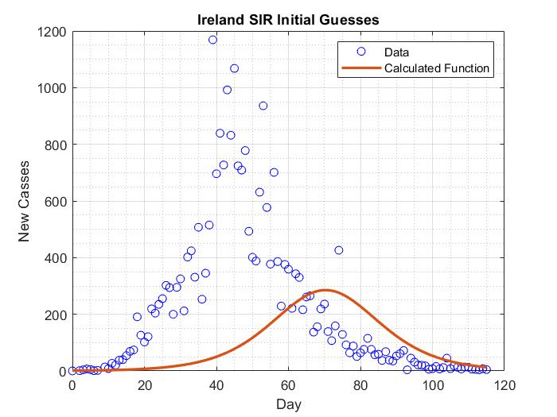
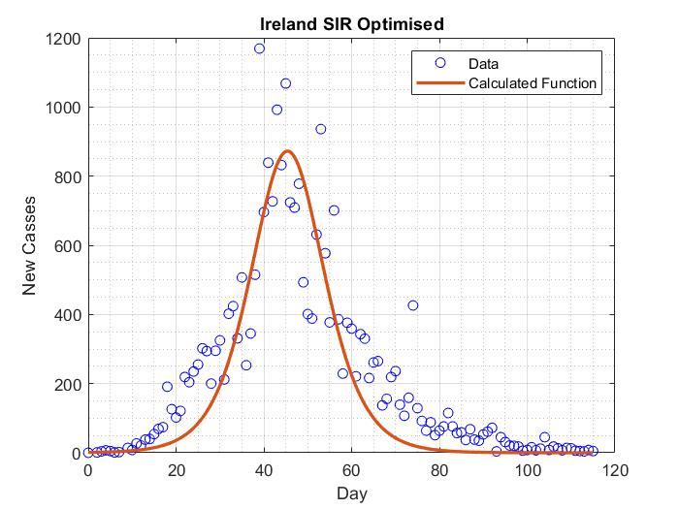
Optimisation Process
Guesses: 𝛽 = 9.3 𝛾 = 9.2
Optimised: 𝛽 = 9.56 𝛾 = 9.38

Slide 15
Comparisons
Country | Initial Beta Guess | Initial Gamma Guess | Optimised Beta | Optimised Gamma | R_0 Value
Ireland | 9.2 | 9.1 | 9.5615 | 9.3818 | 1.0195
Italy | 11.0 | 10.8 | 11.8482 | 11.6745 | 1.0149

Slide 16
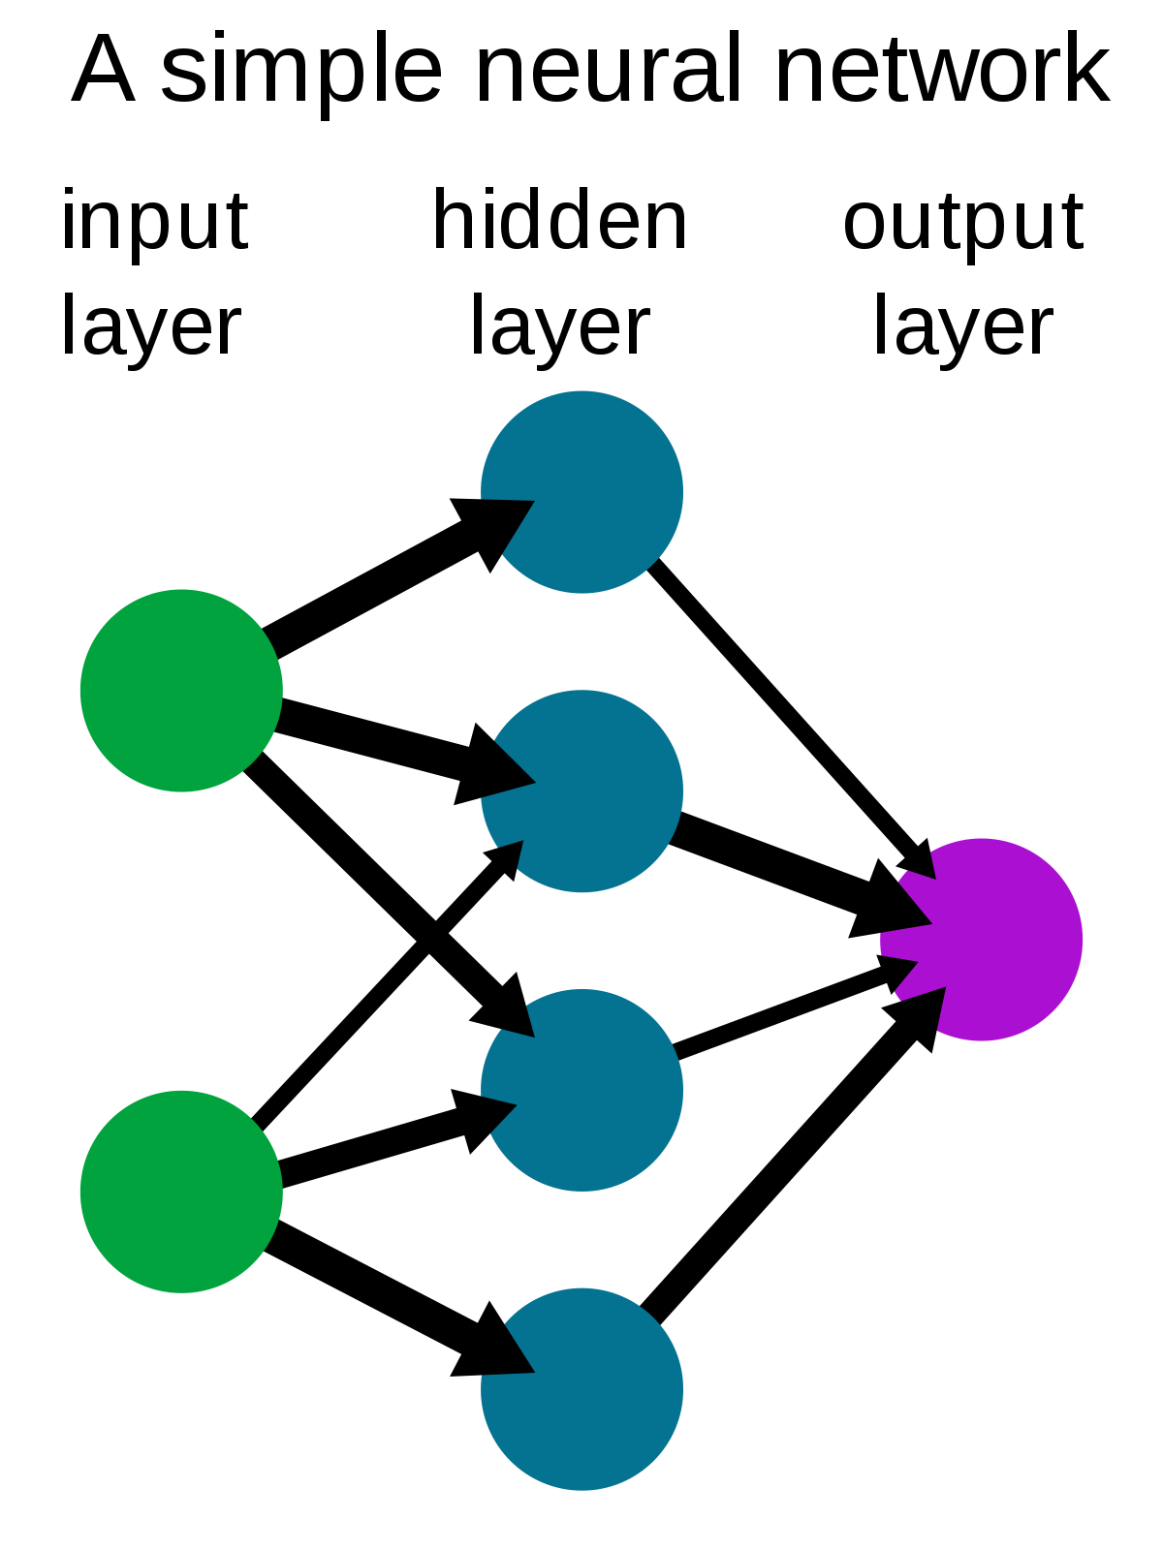
What’s Next?
“Deep learning: An introduction for Applied Mathematicians” by Catherine Higham and Desmond Higham, SIREV 2019
“First-Principles machine learning modelling of Covid-19” by Luca Magri and Nguyen Anh Khoa Doan, SIAM News 2020
Machine Learning:
Train Neural Network on artificial data
Apply to real world figures
Allow coefficients to vary with time
Add in more compartments, SEIR model
Figure: https://en.wikipedia.org/wiki/Neural_network

